Slide 1
FUNDAMENTAL OF AC CIRCUITS
UNIT-II

Slide 2
Problem on Series RL circuit

Slide 4
Series RC circuit
An RC circuit (also known as an RC filter or RC network) stands for a resistor-capacitor circuit. An RC circuit is defined as an electrical circuit composed of the passive circuit components of a resistor (R) and capacitor (C), driven by a voltage source or current source.

Slide 5
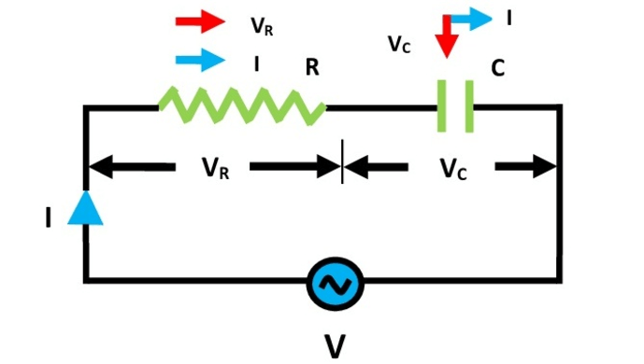
Series RC circuit

Slide 6
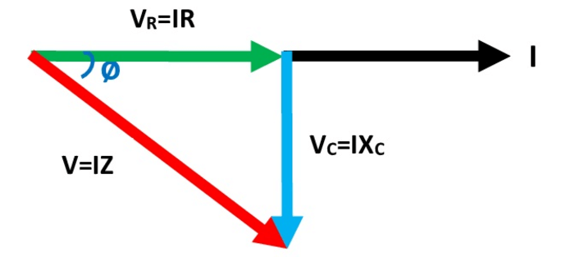
Vector Diagram of RC circuit

Slide 7
Series RC circuit
V_{R} is drawn in phase with current 'I' because in a pure resistor the voltage and current are in phase with each other.
V_{C} is drawn lagging with current 'I' by 90⁰ because in a pure capacitor voltage and current are 90⁰ out of each other i.e. voltage lags current by 90⁰ or current leads the voltage by 90⁰

Slide 8



Series RC circuit

Slide 9
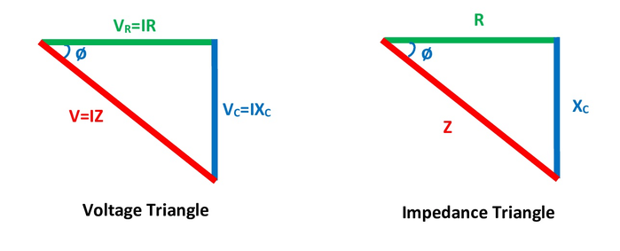
Series RC circuit

Slide 10


Series RC circuit

Slide 11
Problem on Power and RC circuit

Slide 12
Problem on Power and RC circuit

Slide 13
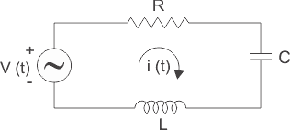
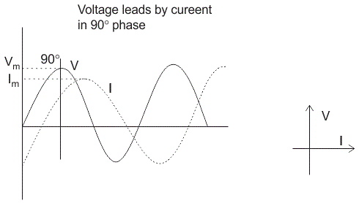
Series RLC circuit
A series RLC circuit is one the resistor, inductor and capacitor are connected in series across a voltage supply. The resulting circuit is called series RLC circuit.

Slide 14
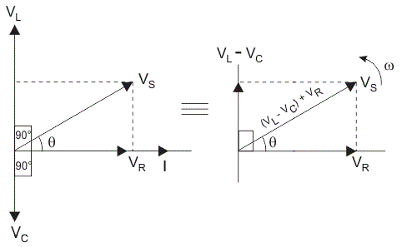
Series RLC circuit

Slide 15
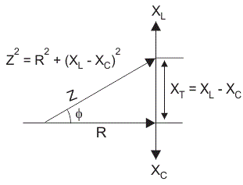
Impedance series RLC circuit

Slide 16
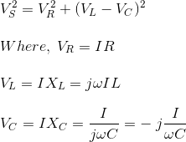
Basic Formulae Series RLC circuit

Slide 17
Problem on Series RLC circuit

Slide 18
Problem on series RLC circuit

Slide 19
1. The impedance at the resonant frequency of a series RLC circuit with L = 20 mH C = 0.02 μF, and R_{W} = 90 Ω is (A) 0 Ω
(B) 90 Ω
(C) 20 Ω
(D) 40 Ω
2. A 12 Ω resistor, a 40 μF capacitor, and an 8 mH coil are in series across an ac source. The resonant frequency is
(A) 28.1 Hz
(B) 281 Hz
(C) 2,810 Hz
(D) 10 kHz

Slide 20
A 24 Ω resistor, an inductor with a reactance of 120 Ω, and a capacitor with a reactance of 120 Ω are in series across a 60 V source. The circuit is at resonance. The voltage across the inductor is (A) 60 V
(B) 660 V
(C) 30 V
(D) 300 V
A 90 Ω resistor, a coil with 30 Ω of reactance, and a capacitor with 50 Ω of reactance are in series across a 12 V ac source. The current through the resistor is
(A) 9 mA
(B) 90 mA
(C) 13 mA
(D) 130 mA

Slide 21
In a series RLC circuit, the phase difference between the current in the capacitor and the current in the resistor is? a) 0⁰ b) 90⁰ c) 180⁰ d) 360⁰
_________ the resonant frequency, the current in the capacitor leads the voltage in a series RLC circuit. a) Above b) Below c) Equal to d) Depends on the circuit

Slide 22
Answer: a Explanation: In a series RLC circuit, the phase difference between the current in the capacitor and the current in the resistor is 0⁰ because same current flows in the capacitor as well as the resistor.
Answer: b Explanation: The current in the capacitor leads the voltage in a series RLC circuit if circuit is capacitive dominant i.e.i.e. if X_{L} < X_{C} ω_{L} < 1/ω_{C} => ω < 1/√LC => ω < ω₀. So, the current in the capacitor leads the voltage in a series RLC circuit below the resonant frequency.

Slide 23
POWER IN AC CIRCUITS

Slide 24
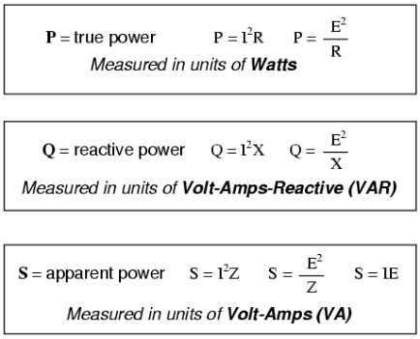
POWER IN AC CIRCUITS

Slide 25
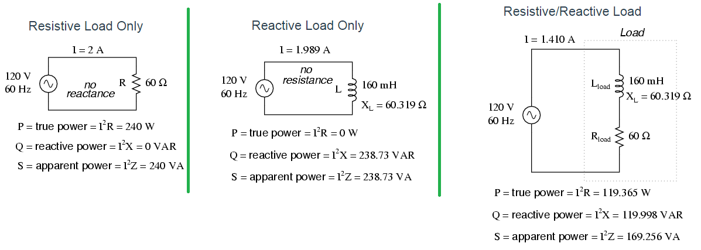
True Power, Reactive Power and Apparent Power with Resistive and Inductive Load

Slide 26
Different types of powers
Instantaneous power is the power which we calculate at any particular instance. It can be positive or negative.
The power which is actually consumed or utilised in an AC Circuit is called True power or Active power or Real power. It is measured in kilowatt (kW) or MW. It is the actual outcomes of the electrical system which runs the electric circuits or load.
The power which always remains positive is called active power. It never changes its direction.
The power which only oscillates back and forth without being used up is called reactive power.

Slide 27
TRUE POWER: The actual amount of power being used, or dissipated, in a circuit is called true power, and it is measured in watts (symbolized by the capital letter P, as always) APPARENT POWER: The combination of reactive power and true power is called apparent power, and it is the product of a circuit’s voltage and current, without reference to phase angle. Apparent power is measured in the unit of Volt-Amps (VA) and is symbolized by the capital letter S. REACTIVEPOWER We know that reactive loads such as inductors and capacitors dissipate zero power, yet the fact that they drop voltage and draw current gives the deceptive impression that they actually do dissipate power. This “phantom power” is called reactive power, and it is measured in a unit called Volt-Amps-Reactive (VAR), rather than watts. The mathematical symbol for reactive power is (unfortunately) the capital letter Q.

Slide 28
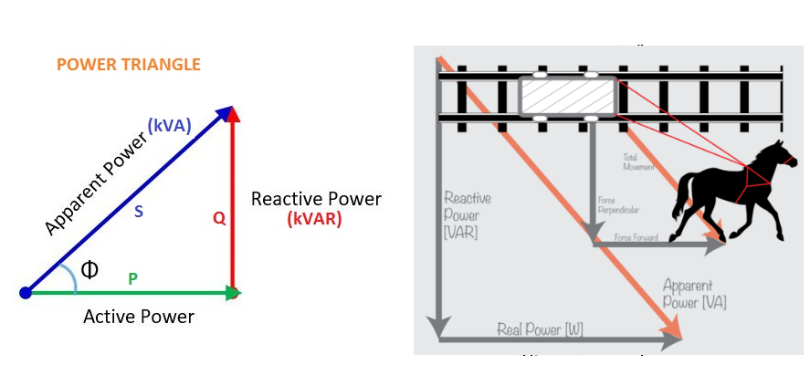
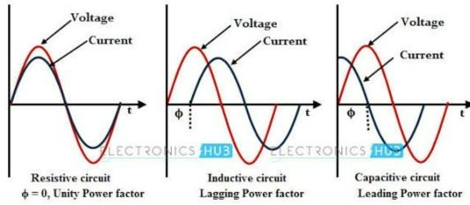
Active and Reactive Power

Slide 29
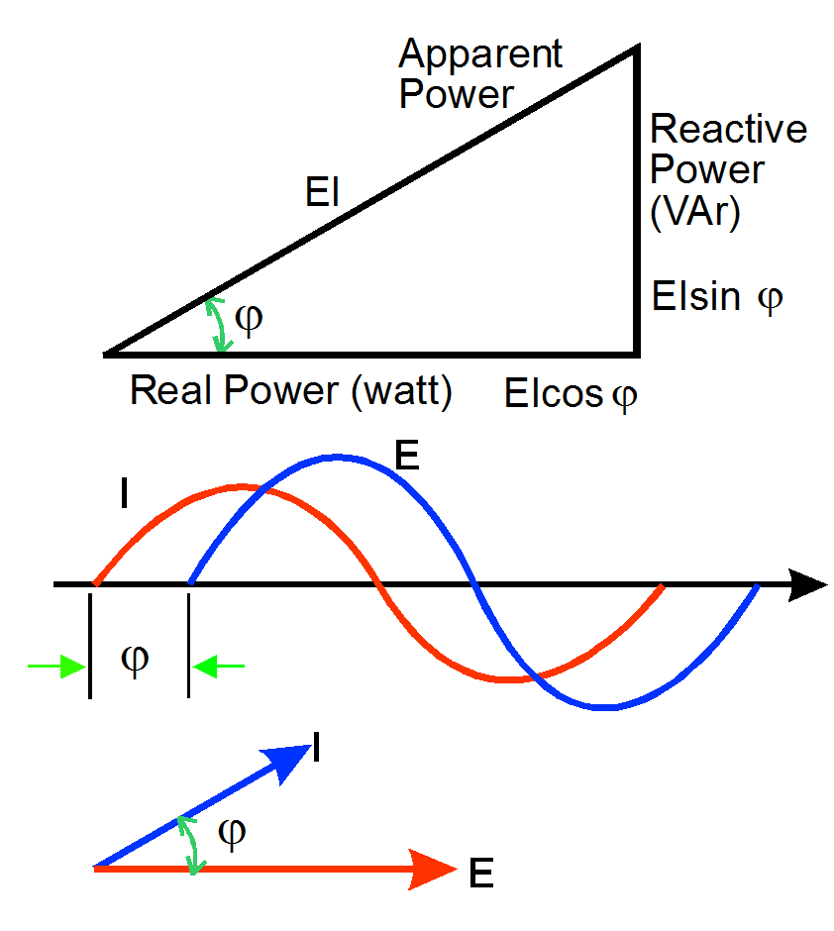
POWER TRIANGLE

Slide 30
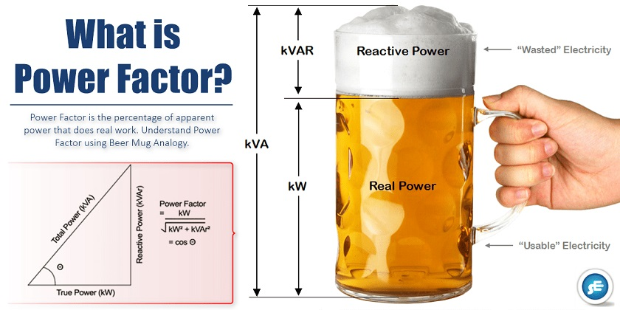

Slide 31
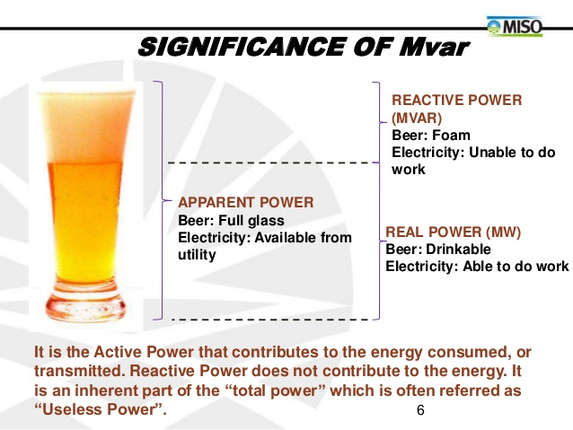

Slide 32
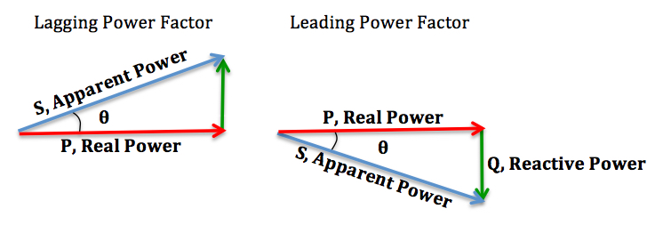
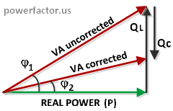

Slide 33
Q1. What is maximum value of power factor? a. 0.5 b. 1 c. 1.5 d. 0.95

Slide 34
Q2. Active power and apparent power are respectively represented by? a. kW and kVAR b. kVAR and kVA c. kVA and kVAR d. kW and kVA

Slide 35
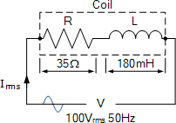
A wound coil that has an inductance of 180mH and a resistance of 35Ω is connected to a 100V 50Hz supply. Calculate: a) the impedance of the coil, b) the current, c) the power factor, and d) the apparent power consumed.
Also draw the resulting power triangle for the above coil. Data given: R = 35Ω, L = 180mH, V = 100V and ƒ = 50Hz.
(a) Impedance (Z) of the coil:
12

Slide 36
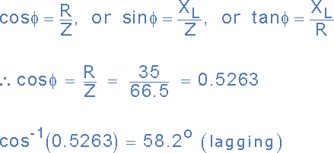
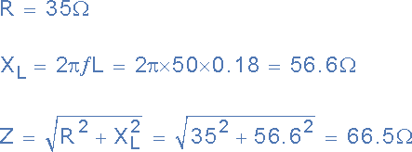
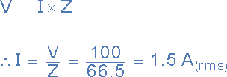
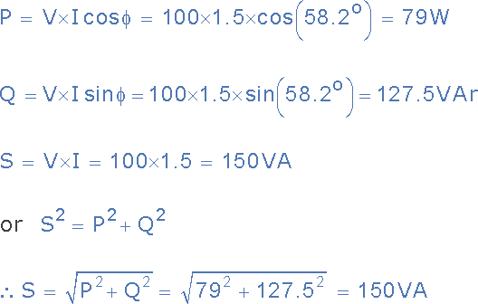
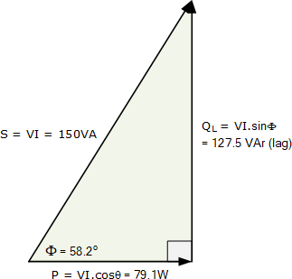
13

Slide 37
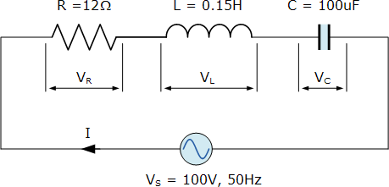
A series RLC circuit containing a resistance of 12Ω, an inductance of 0.15H and a capacitor of 100uF are connected in series across a 100V, 50Hz supply. Calculate the total circuit impedance, the circuits current, power factor and draw the voltage phasor diagram.
14

Slide 38

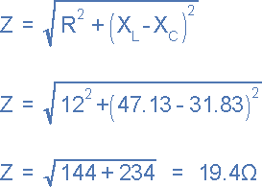

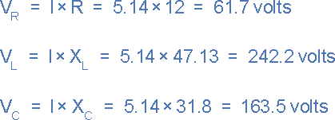
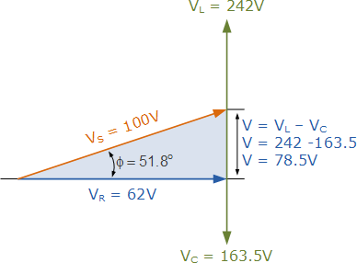
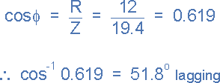
15

Slide 39
The power factor of an ac circuit is equal to:
a) Cosine of the phase angle
b) Sine of the phase angle
c) Tangent of the phase angle
d) Cotangent of the phase angle

Slide 40
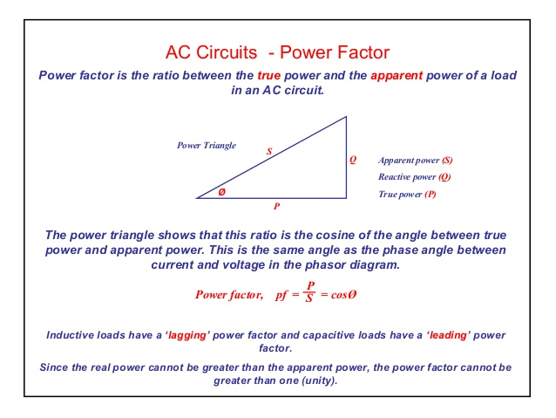
Concept of Power Factor

Slide 41
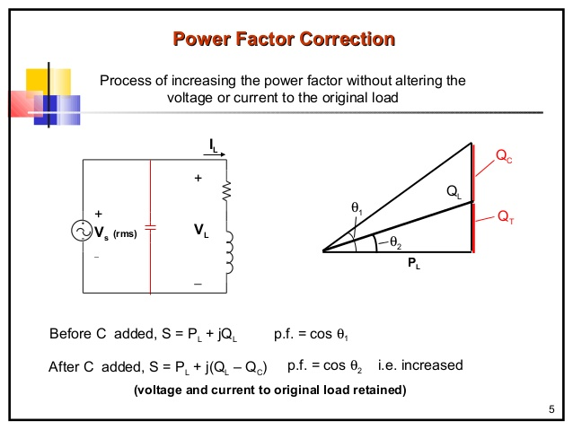

Slide 42
Resonance
Resonance is the phenomenon in the electrical circuit, where the output of the circuit is maximum at one particular frequency. And that frequency is known as the resonant frequency. At the resonant frequency, The capacitive reactance and inductive reactance are equal.
In the RLC series circuit, when the circuit current is in phase with the applied voltage, the circuit is said to be in Series Resonance. The resonance condition arises in the series RLC circuit when the inductive reactance is equal to the capacitive reactance.
X_{L} = X_{C} or (X_{L} – X_{C} = 0)
A series resonant circuit has the capability to draw heavy current and power from the mains; it is also called acceptor circuit. The series resonance RLC circuit is shown in the figure below:

Slide 43
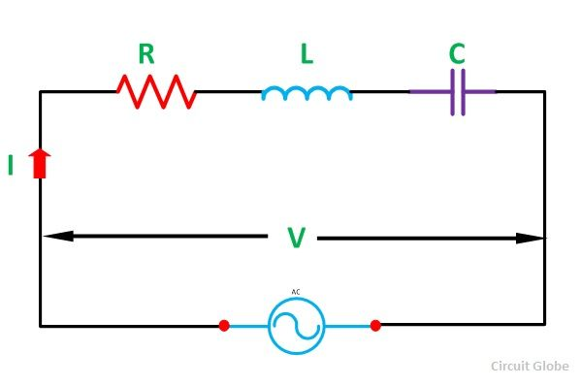
Resonance

Slide 44

Resonance
Where Zr is the resonance impedance of the circuit.
Putting the value of X_{L} – X_{C} = 0 in equation (1) we will get:
Zr = R
Current I = V/ Zr = V/R
Since at resonance the opposition to the flow of current is only resistance (R) of the circuit. At this condition, the circuit draws the maximum current.

Slide 45
Effects of Series Resonance
The following effects of the series resonance condition are given below:
At resonance condition, XL = XC the impedance of the circuit is minimum and is reduced to the resistance of the circuit. i.e Zr = R
At the resonance condition, as the impedance of the circuit is minimum, the current in the circuit is maximum. i.e Ir = V/Zr = V/R
As the value of resonant current Ir is maximum hence, the power drawn by the circuit is also maximized. i.e Pr = I²Rr
At the resonant condition, the current drawn by the circuit is very large or we can say that the maximum current is drawn. Therefore, the voltage drop across the inductance L i.e (V_{L} = IX_{L} = I x 2πfrL) and the capacitance C i.e (V_{C} = IX_{C} = I x I/2πfrC) will also be very large.
In the power system, at the resonant condition, the excessive voltage is built up across the inductive and capacitive component of the circuit such as circuit breaker, reactors, etc., may cause damage. Therefore, the series resonant condition is avoided in the power system.
However, in some of the electronics devices such as antenna circuit of radio and TV receiver, tunning circuit, etc. The series resonant condition is used to increase the signal voltage and current at the desired frequency (fr).

Slide 46
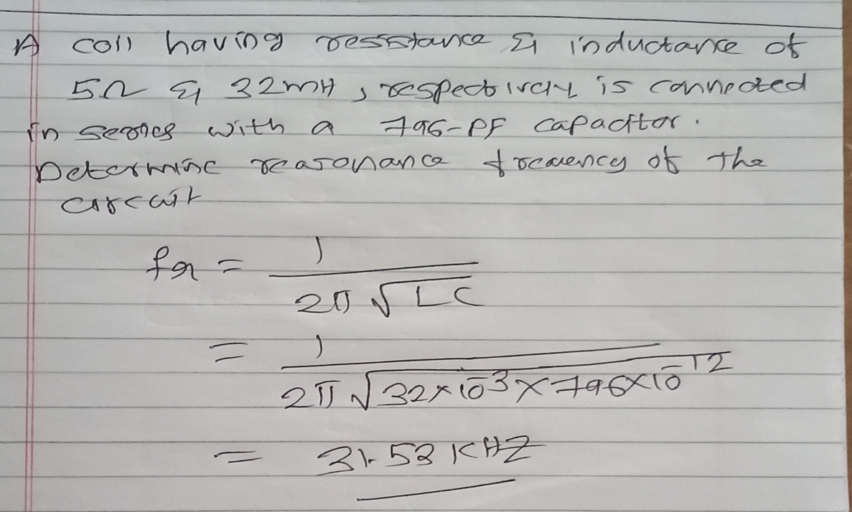
Problem on Resonance

Slide 47
The voltage across the LC combination in a series RLC circuit is?
A 3
B 6
C 0
D None
14

Slide 48
Answer: 0
15

Slide 49
f the value of C in a series RLC circuit is decreased, the resonant frequency
A Increases
B Is not affected
C Is reduced to zero
D None of these
16

Slide 50
Answer: Increases
17

Slide 51
In a series RLC circuit that is operating above the resonant frequency, the current
A Is in phase with the applied voltage
B Leads the applied voltage C Lags the applied voltage D None of these
18

Slide 52
Answer: Lags the applied voltage
19

Slide 53
1. A 9 mH coil is in parallel with a 0.015 μF capacitor across an 18 kHz ac source. The coil's internal resistance R_{W}, is 60 Ω. The circuit impedance is (A) 17,340 Ω
(B) 1,734 Ω
(C) 290 Ω
(D) 1,018 Ω
20

Slide 54
Answer: Option A
21

Slide 55

THREE PHASE SYSTEM
BASICS
Line voltage VL= voltage between lines
Phase voltage Vph= voltage between a line and neutral

Slide 56
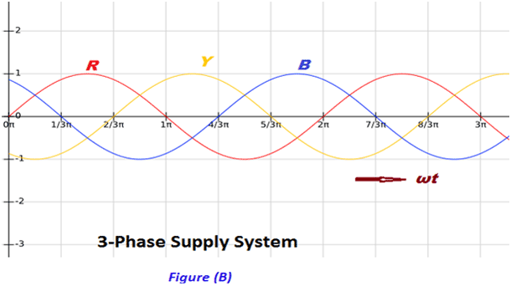
3 Phase system

Slide 57
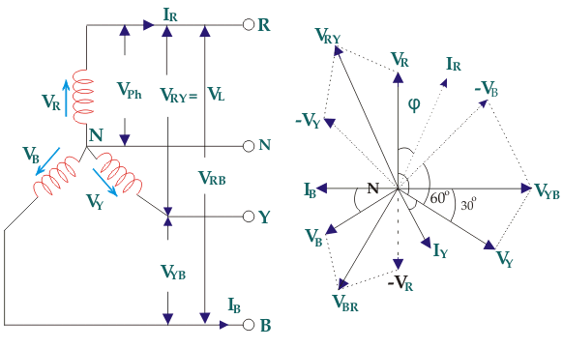
Star connection

Slide 58
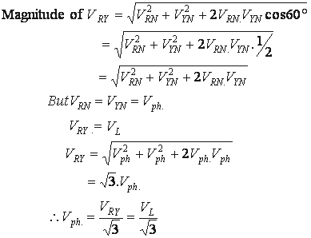
Derivation between line voltage and phase voltage

Slide 59
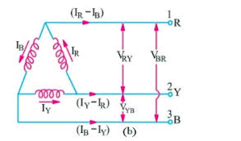
Delta Connection

Slide 60
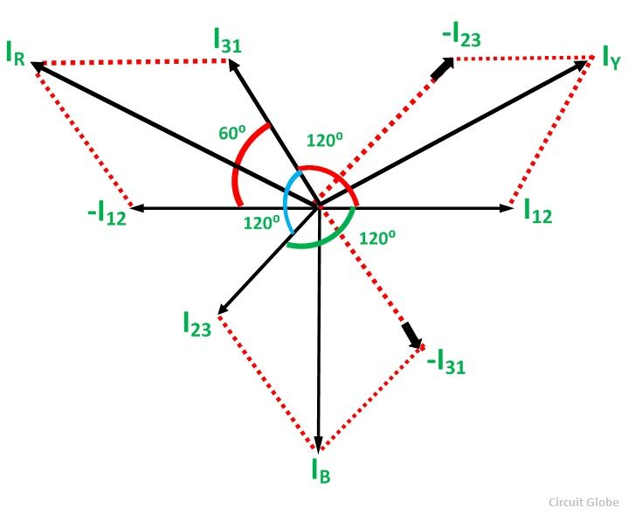
Phasor diagram

Slide 61



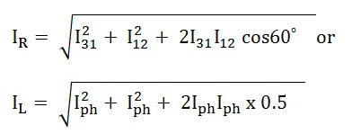


Derivation of Delta connection
Applying Kirchhoff’s Law at junction 1,
The Incoming currents are equal to outgoing currents.

Slide 62
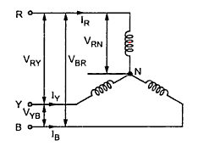
THREE PHASE SYSTEM
BALANCED STAR
Line Voltage VL= √3 Vph
Line current IL = Iph

Slide 63
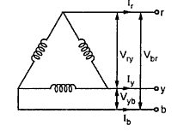
THREE PHASE SYSTEM
BALANCED DELTA
Line Voltage VL= Vph
Line current IL = √3 Iph

Slide 64
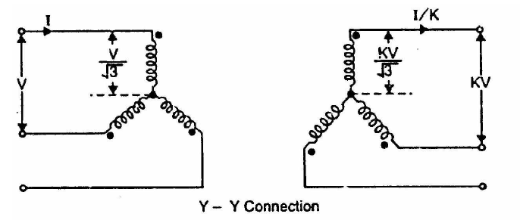
Star- Star connection
This connection satisfactory only in balanced load otherwise neutral point will be shifted.

Slide 65
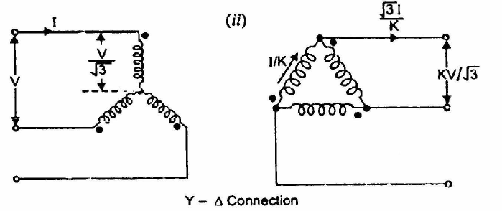
Star- Delta connection
Used to step down voltage ie end of transmission line

Slide 66
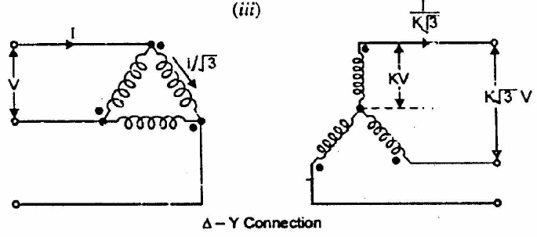
Delta - Star connection
This connection is used to step up voltage ie. Beginning of high tension line

Slide 67
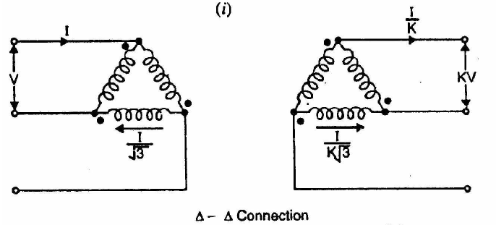
Delta - Delta connection
This connection is used for moderate voltages

Slide 68
Delta - Delta connection
Advantages
System voltages are more stable in relation to
unbalanced load
2. If one t/f is failed it may be used for low power
level ie V-V connection
3. No distortion of flux ie 3rd harmonic current not
flowing to the line wire

Slide 69
Delta - Delta connection
Disadvantages
Compare to Y-Y require more insulation
2. Absence of star point ie fault may severe

Slide 70
Star- Delta connection
Advantages
The primary side is star connected. Hence fewer number of turns are required. This makes the connection economical
The neutral available on the primary can be earthed to avoid distortion.
Large unbalanced loads can be handled satisfactory.

Slide 71
Star- Delta connection
Disadvantages
The secondary voltage is not in phase with the primary. (30 ⁰ phase difference )
Hence it is not possible to operate this connection in parallel with star-star or delta-delta connected transformer.

Slide 72
Star- Delta connection
Disadvantages
The secondary voltage is not in phase with the primary. (30 ⁰ phase difference )
Hence it is not possible to operate this connection in parallel with star-star or delta-delta connected transformer.

Slide 73
Delta - Star connection
This connection is used to step up voltage ie. Beginning of high tension line

Slide 74
Delta - Star connection
Features
secondary Phase voltage is 1/√3 times of line voltage
neutral in secondary can be grounded for 3 phase 4 wire system
Neutral shifting and 3rd harmonics are there
Phase shift of 30⁰ between secondary and primary currents and voltages

